Slide 1
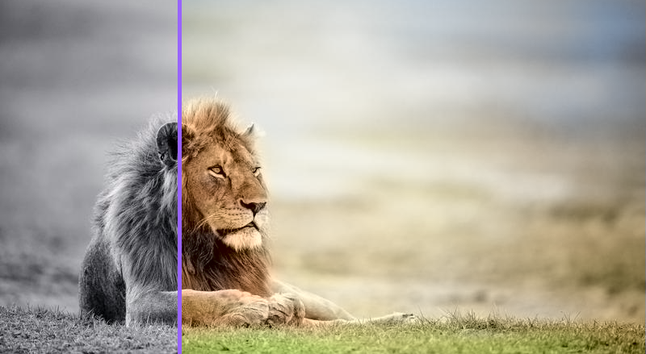
DEEP LEARNING BASED COLORIZATION FOR VISUAL MEDIA

Slide 2
Team Members
Ahmed Mohamed Abdullah.
Ahmed Salah Khodair.
Omar Sayed Mostafa.
Mohamed Kamel Sayed.
Supervisors
DR . Mohammed Marey.
TA . Bassel Safwat.

Slide 3
Agenda
Problem Definition
Objective
Related Work
Model Architecture
Model Component
Training Process
Results
Demo Run
Accuracy
Time Plan
APIs & Tools
References

Slide 4
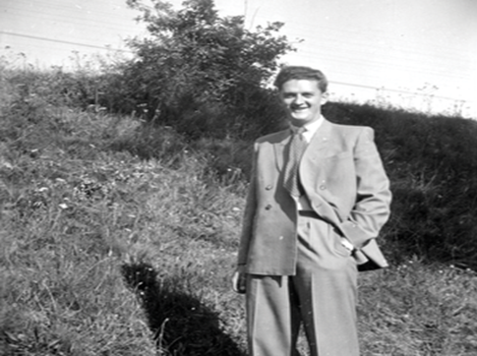
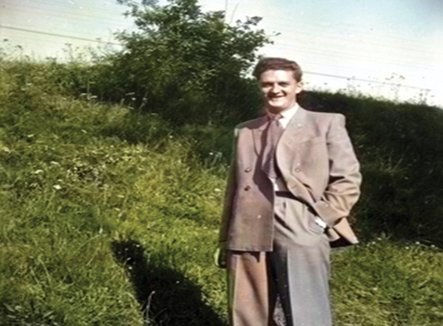
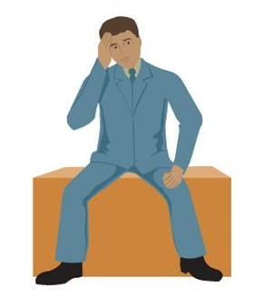
Problem Definition
Mapping a specific grey level of a pixel into different colors using deep learning.
Grayscale Image

Slide 5
Objective
Our target is to build a model which automatically colorize grayscale images without any user interactions based on Convolution Neural Networks.
Converting grayscale images to color images

Slide 6
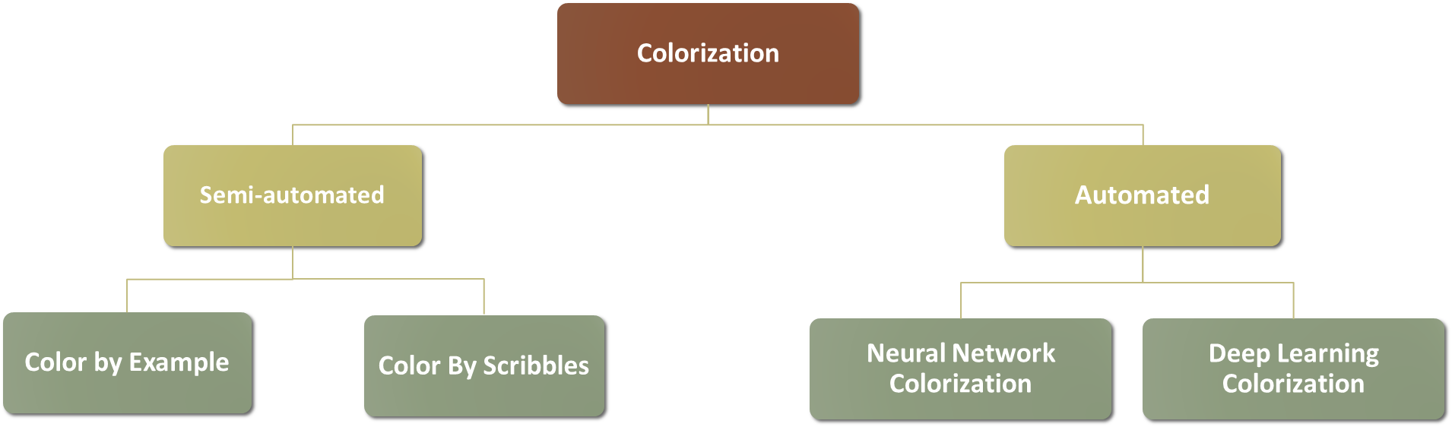
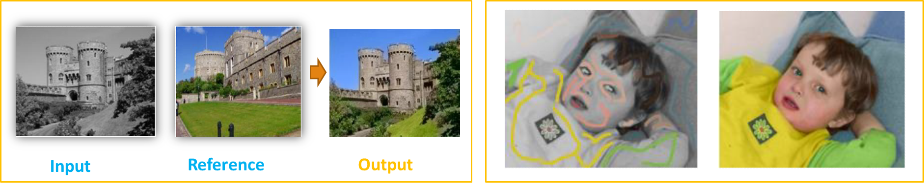
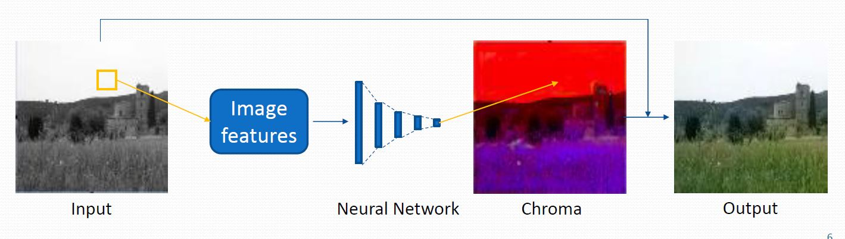
Related work

Slide 7
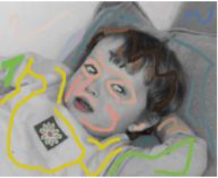
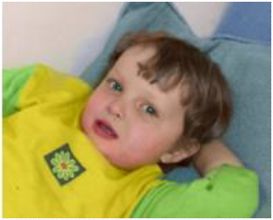
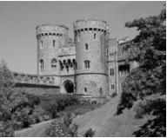
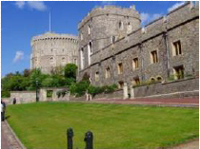
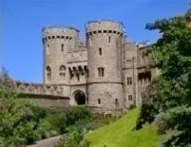
Related work “Semi-Automated” Colorization
1.Example-based colorization
General technique to colorize grayscale images by matching the luminance and texture information between images.
2. Scribble-based colorization
Normally requires human-labelled color scribbles on the grayscale target image .The color information on the scribbles are then propagated to the rest of the target image.
Input
Reference
Output
[Gupta+ 2012]
[Levin 2004]

Slide 8
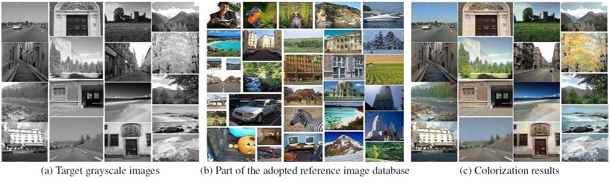
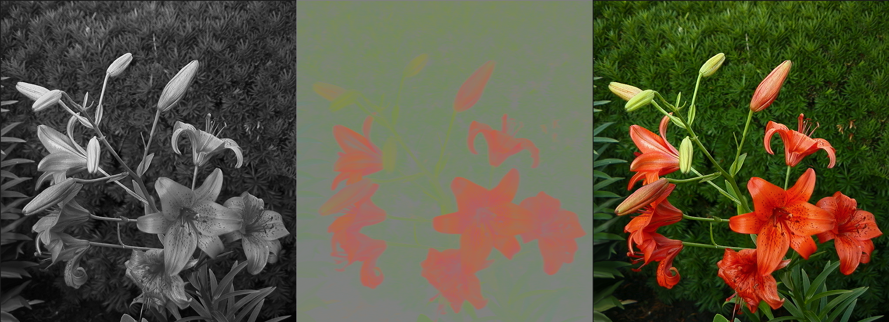
Related work “Automated” Colorization
Luminance
Chrominance
Luminance & chrominance
[Cheng 2015 testing Architecture]

Slide 9
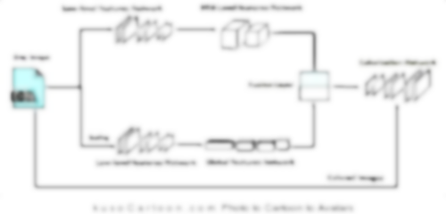
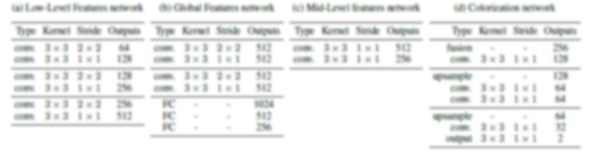
Model Architecture

Slide 10
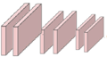
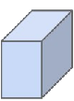



Model Architecture Training Part
Low-level features Network
Mid-Level features Network
Grey Images
Colorization Network
Fusion Layer
MLP
Scaling
Low-level features Network
Global features Network
Colored Images

Slide 11
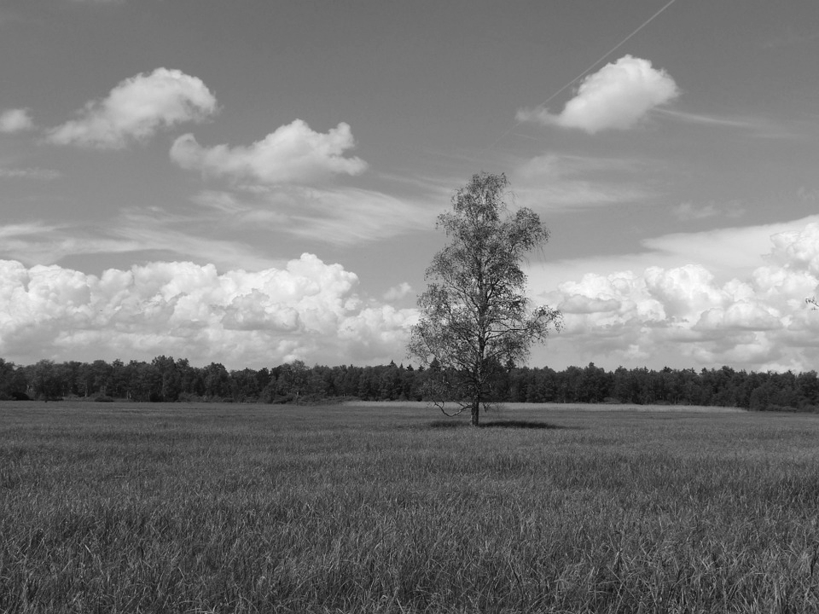
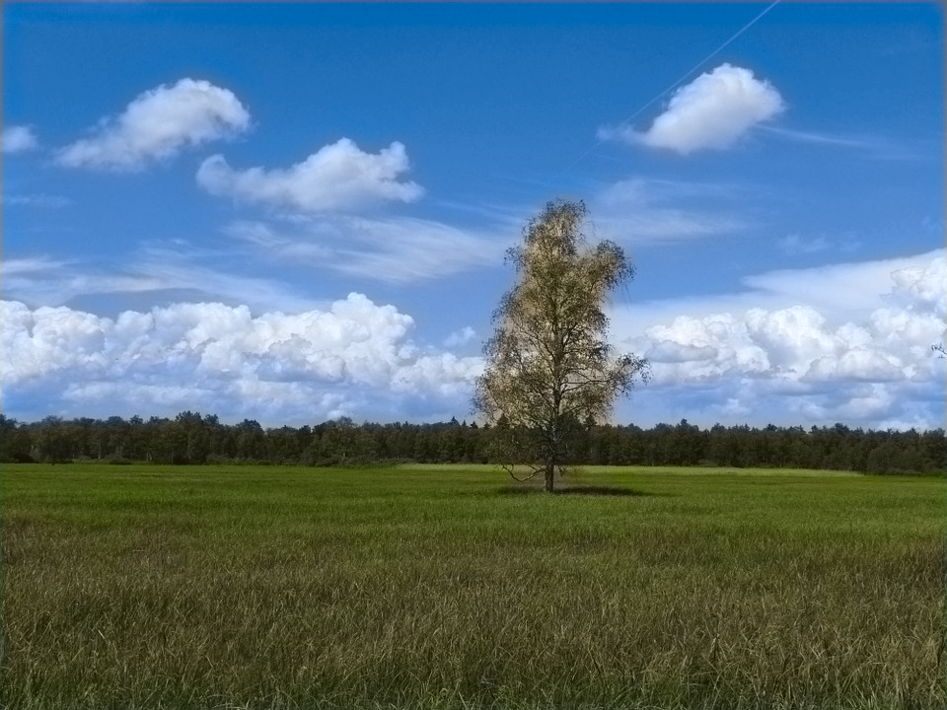
Model Architecture Testing Part
Grayscale Image
Color Image
Pre-trained
DEEP LEARNING BASED COLORIZATION FOR VISUAL MEDIA

Slide 12
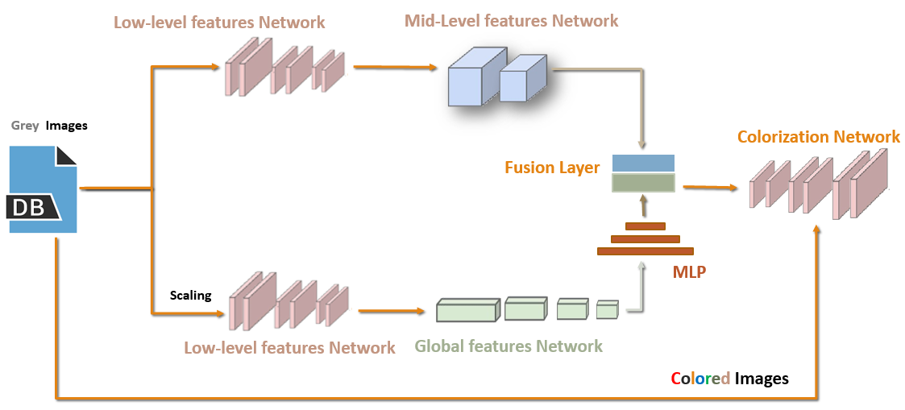
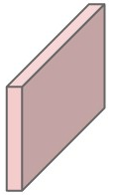
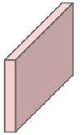

Model Components
Low level Features Network
Is Convolutional Neural Network which Extract low level features such as edges and corners to feed the global and mid level features networks with them.
It is takes greyscale images as input to train the network
Six Convolutional Layers
Grayscale image
Output of low level feature network

Slide 13
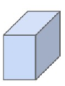
Model Components continue
Mid level Features Network
Is a Convolutional Neural Network which Extract Mid features such as textures or objects based on the low level features .
It takes the shared low level features as input to train the Network with them and contain many convolutional layers to get many mid-level features.
The output of low level network
The output of mid level network
Two Convolutional Layers

Slide 14
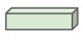
Model Components continue
Global level Features Network
Is a Convolutional Neural Network which Compute a global features vector representation of the image based on the low level features .
The global features vector indicate what type of image the input is such as the image is taken indoor or outdoor .
Four Convolutional Layers
The output of low level network
The output of Global level network

Slide 15
Model Components continue
Fusion layer
Combine the global features with the mid-level features .
We combine them because the global features act as an image prior on the local features
to indicate what type of image the input is.
It is a DLNN of one layer which take the global features network outputs and the mid-level features network outputs as input to this layer and the output is a fused features .
Mid Feature
Global Feature
Fusion Layer
Mid-Level Network Output
Global Network Output

Slide 16
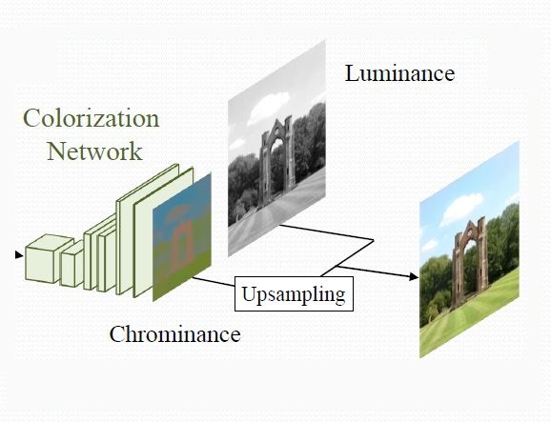
Model Components continue
Colorization Network
Is a Convolutional Neural Network which consists of a set of convolutions and up-sampling layers.
The output is 224x224x2 that indicates to size of image and ‘ab’ values of the L*a*b color space which is fused with L of grayscale input to form the colored input.

Slide 17
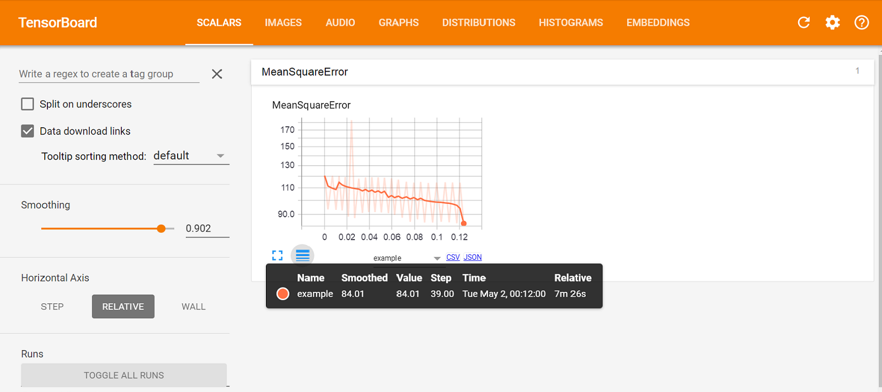
Model Training

Slide 18
Training Phase
Prepare Dataset.

Slide 19
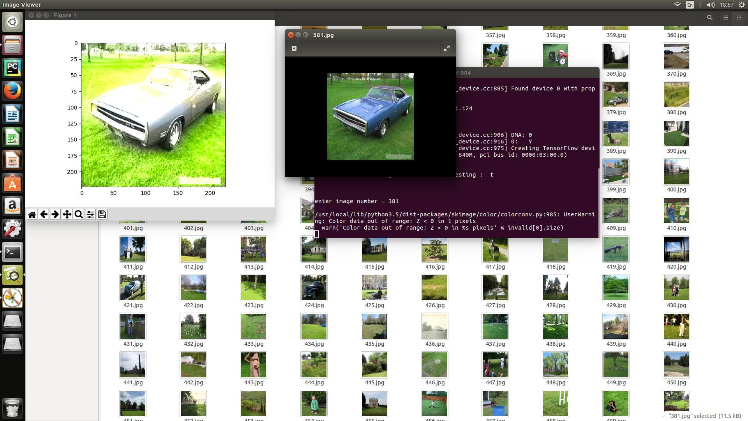

Training Phase
2. Calculate the Error
# MSE $Los= {‖ {Y_{ }^{Output}}^{ }−Y_{ }^{Target}‖ }_{FRO}^{2}.$
Ground Truth
Result

Slide 20
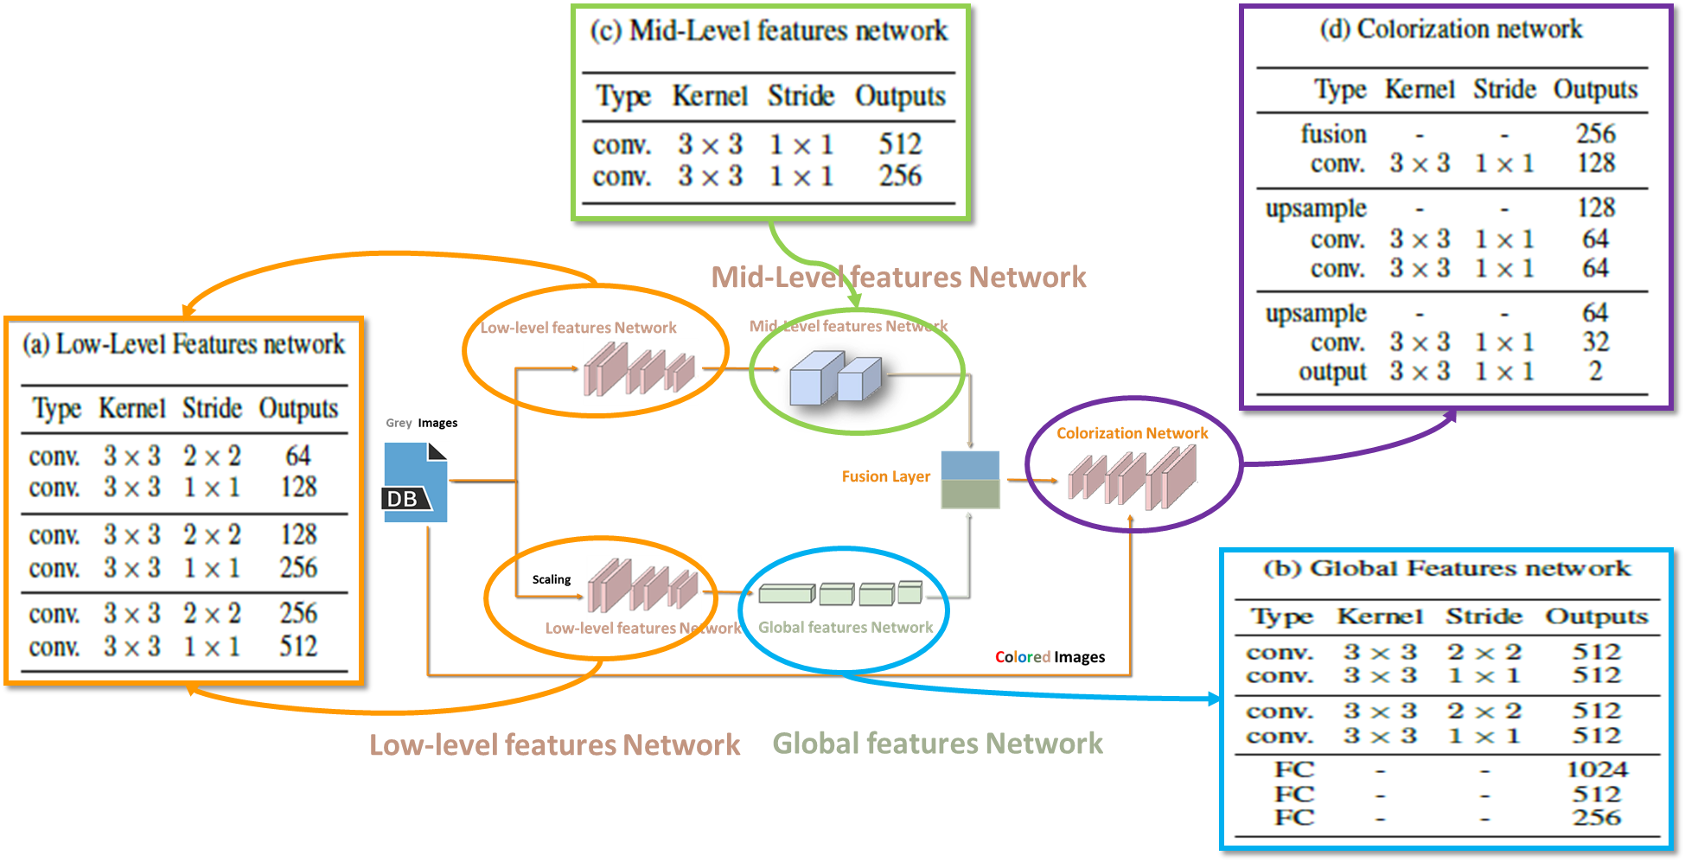
Training Phase
3. Update Networks Weights

Slide 21
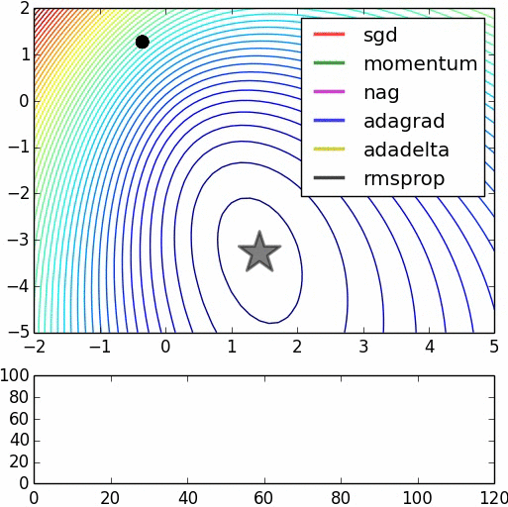
Training Phase continue…
Optimizers:
Instead of having to experiment and heuristically determine a good learning rate scheduler, we sidestep the problem by using the ADADELTA optimizer.
This approach adaptively sets the learning rates for all the network parameters without requiring us to set a global learning rate.

Slide 22
Training Problems.
Implementation Problems
Training phases require high computation process

Slide 23

TensorFlow
Is An open-source software library for Machine Intelligence. TensorFlow was originally developed by researchers and engineers working in the Google Brain Team within Google's Machine Intelligence research organization.
TensorFlow released as open source software on November 9, 2015.
TensorFlow can run on multiple CPUs and GPUs (with optional CUDA extensions for general-purpose computing on graphics processing units).
The name TensorFlow derives from the operations which such neural networks perform on multidimensional data arrays. These multidimensional arrays are referred to as "tensors".

Slide 24
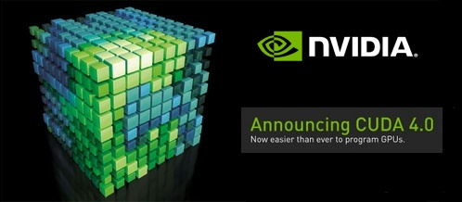
CUDA stands for Compute Unified Device Architecture.
The NVIDIA CUDA® Deep Neural Network library (cuDNN) is a GPU-accelerated library of primitives for deep neural networks. cuDNN provides highly tuned implementations for standard routines such as forward and backward convolution, pooling, normalization, and activation layers. cuDNN is part of the NVIDIA Deep Learning SDK.

Slide 25

Demo Run

Slide 26
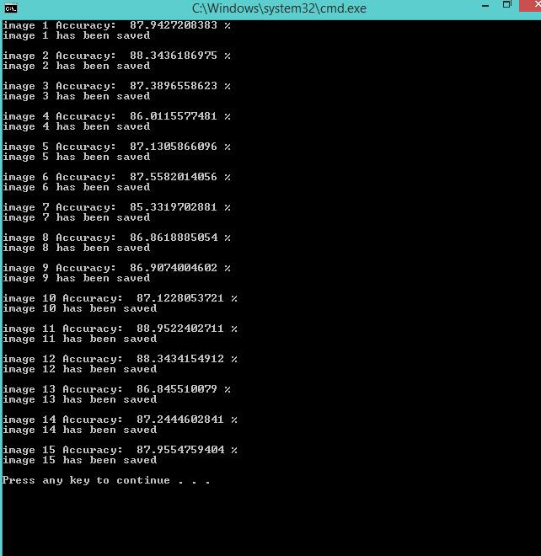
Accuracy

Slide 27
Future Work
Classification Network Image Classification to improve colorization process .
Frame Reduction + spread color To speed up Video colorization process .

Slide 28
Time Plan
Task – Time Plan | 2016 Q4 |  |  | 2017 Q1 |  |  | 2017 Q2
 | Oct | Nov | Dec | Jan | Feb | Mar | Apr | May | Jun
Video Colorization Survey
Networks Construction
Colorization Network
Training + Testing On Image
Video Colorization
Finalizing Project
Documentation
Implementation

Slide 29





API & Tools
Python
PyCharm

Slide 30
Reference
[1] Let there be Color!: Joint End-to-end Learning of Global and Local Image Priors for Automatic Image Colorization with Simultaneous Classification 2016
[2] Cheng Deep Colorization ICCV 2015
[3] TensorFlow
[4] Python

Slide 31
Thank You

